Slide 1


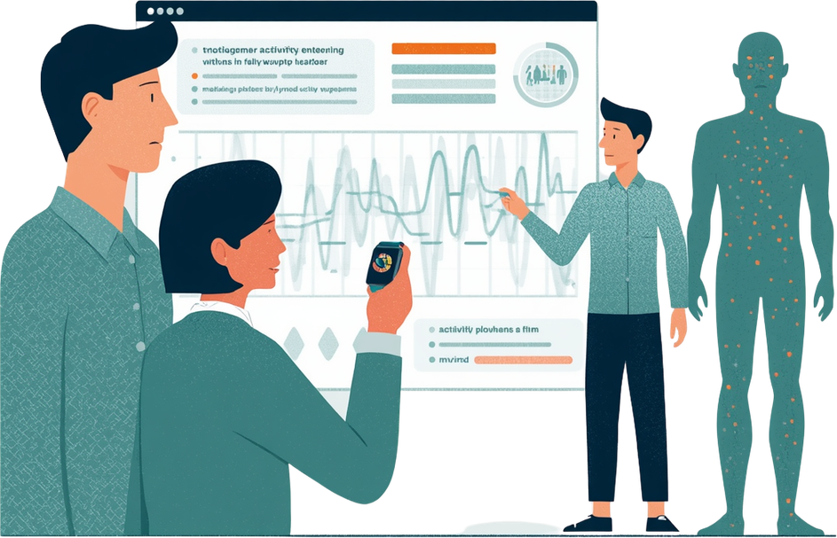
Using Deep Learning
Human Activity
Recognition
Student Name | Course Name | Date
Presented by:
Student Name

Slide 2


Project
Motivation
Human Activity Recognition (HAR) is transforming wearable AI technology. Key healthcare applications include rehabilitation monitoring, elderly fall detection, and chronic disease management. HAR enables continuous patient tracking, personalized therapy adjustments, and early intervention for at-risk populations.

Slide 3



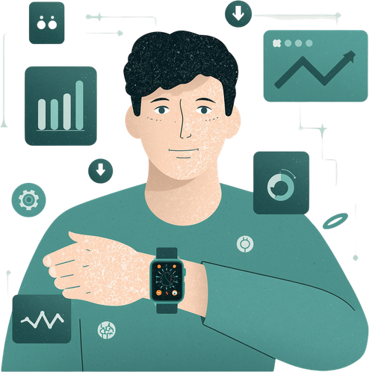
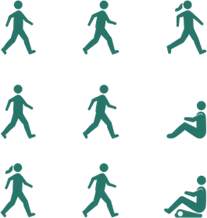

Dataset
Overview
UCI HAR Dataset
Benchmark dataset for human activity recognition research.
Dual Sensors
Accelerometer and Gyroscope capture motion data.
Six Activities
Walking, upstairs, downstairs, sitting, standing, laying.
Tensor Shape
7352 samples × 128 timesteps × 9 channels.

Slide 4




Exploratory
Data Analysis
Sensor signal analysis reveals distinct patterns between dynamic activities (walking, climbing stairs) showing high-frequency oscillations, and static activities (sitting, standing, laying) displaying stable, low-variance signals. Accelerometer data captures motion intensity while gyroscope readings indicate rotational movements.

Slide 5




Baseline LSTM
Model
The baseline model uses Long Short-Term Memory (LSTM) networks to capture temporal dependencies in sequential sensor data. LSTMs excel at learning patterns across 128 timesteps. Training employed Adam optimizer, categorical cross-entropy loss, and early stopping callbacks to prevent overfitting.

Slide 6



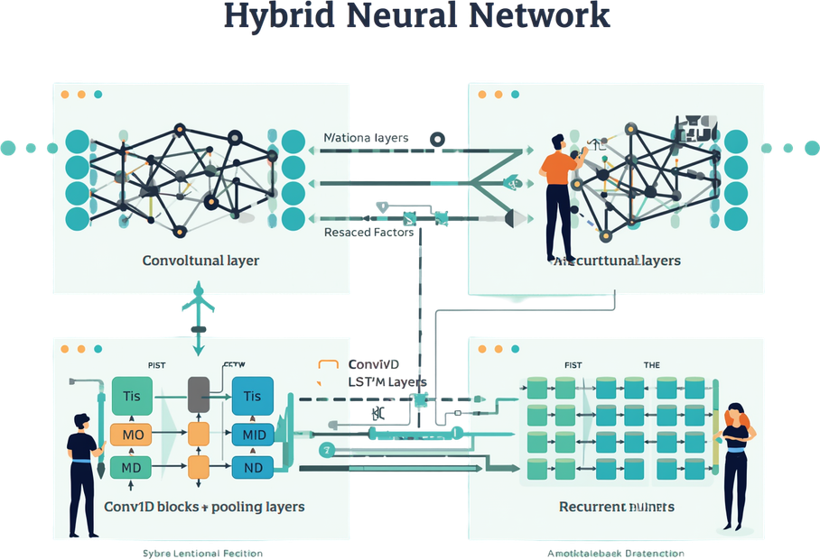
CNN-LSTM
Hybrid Model
The CNN-LSTM hybrid architecture combines Conv1D layers with MaxPooling for local feature extraction, followed by LSTM layers for temporal modeling. This approach captures both short-term patterns in sensor signals and long-term sequential dependencies, offering improved feature representation over the baseline LSTM model.

Slide 7



Model Results
Comparison
LSTM achieved ~89.9% validation and ~88.97% test accuracy, while CNN-LSTM reached ~91.3% validation but ~88.46% test accuracy. Higher validation scores don't guarantee better generalization.

Slide 8


Confusion Matrix
Analysis
Classification errors reveal key insights into model behavior. Walking-related activities (walking, walking upstairs, walking downstairs) show frequent confusion due to similar motion patterns. Sitting vs standing poses challenges from minimal sensor variation. The laying activity achieves strong recognition with near-perfect accuracy due to its distinct signal signature.

Slide 9





Key Findings
Validation vs Real-World Gap
Temporal Modeling Matters
Architecture Impact
Model Stability
Higher validation accuracy does not guarantee better real-world performance.
Sequential dependencies are critical for activity recognition.
Design choices affect confusion patterns.
LSTM shows more consistent temporal behavior.

Slide 10


Streamlit Application
Demo
The interactive Streamlit application enables live HAR predictions, real-time signal visualization, and interactive sample selection. Users can explore how deep learning models classify activities, demonstrating practical integration of HAR technology.

Slide 11


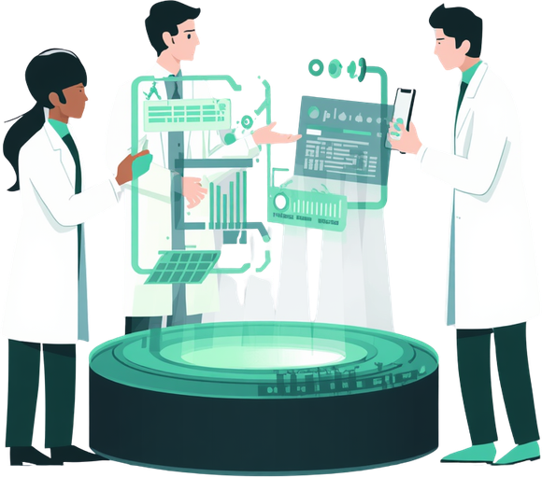



Future
Work
Real-time Wearable AI
Deploy models on edge devices for live activity monitoring.
Rehabilitation Integration
Integrate HAR into rehabilitation and elderly care systems.
Sensor Fusion
Combine multiple sensor modalities for improved accuracy.
Cognitive-Motor Analysis
Explore HEG integration and cognitive-motor pattern analysis.

Slide 12


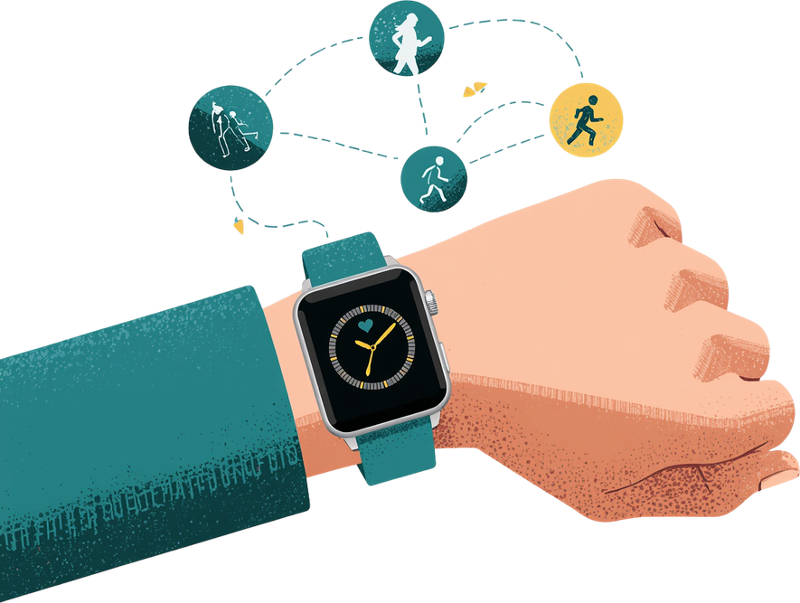
Conclusion
Deep learning effectively recognizes human activities from wearable sensor data. The LSTM model demonstrates more stable temporal behavior compared to CNN-LSTM, making it reliable for sequential pattern recognition. HAR technology shows strong potential for wearable healthcare AI applications, from rehabilitation monitoring to elderly care systems.

Slide 13


Human Activity Recognition Using Deep Learning
Thank
You
Questions and discussion welcome
Deep Learning for Wearable AI

